Slide 1

More attacks on block ciphers
Online Cryptography Course Dan Boneh
Block ciphers

Slide 2
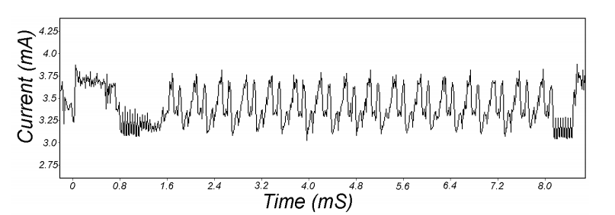
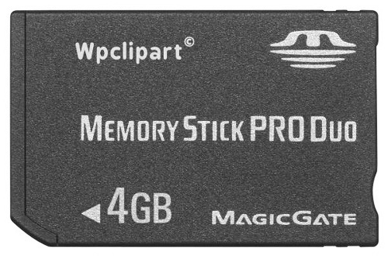
Attacks on the implementation
1. Side channel attacks:
Measure time to do enc/dec, measure power for enc/dec
2. Fault attacks:
Computing errors in the last round expose the secret key k
⇒ do not even implement crypto primitives yourself …
smartcard
[Kocher, Jaffe, Jun, 1998]
Notes:
Many timing attacks: cache timing, multi-core attacks, smartcard attacks

Slide 3
Linear and differential attacks [BS’89,M’93]
Given many inp/out pairs, can recover key in time less than 2⁵⁶ .
Linear cryptanalysis (overview) : let c = DES(k, m)
Suppose for random k,m :
Pr[ m[i₁]⨁⋯⨁m[i_{r}] ⨁ c[j_{j}]⨁⋯⨁c[j_{v}] = k[l₁]⨁⋯⨁k[l_{u}] ] = ½ + ε
For some ε. For DES, this exists with ε = 1/2²¹ ≈ 0.0000000477
Notes:
If S-boxes were random, then ε = 1/2¹⁰

Slide 4
Linear attacks
Pr[ m[i₁]⨁⋯⨁m[i_{r}] ⨁ c[j_{j}]⨁⋯⨁c[j_{v}] = k[l₁]⨁⋯⨁k[l_{u}] ] = ½ + ε
Thm: given 1/ε² random (m, c=DES(k, m)) pairs then
k[l₁,…,l_{u}] = MAJ [ m[i₁,…,i_{r}] ⨁ c[j_{j},…,j_{v}] ]
with prob. ≥ 97.7%
⇒ with 1/ε² inp/out pairs can find k[l₁,…,l_{u}] in time ≈1/ε² .

Slide 5
Linear attacks
For DES, ε = 1/2²¹ ⇒
with 2⁴² inp/out pairs can find k[l₁,…,l_{u}] in time 2⁴²
Roughly speaking: can find 14 key “bits” this way in time 2⁴²
Brute force remaining 56−14=42 bits in time 2⁴²
Total attack time ≈2⁴³ ( << 2⁵⁶ ) with 2⁴² random inp/out pairs

Slide 6
Lesson
A tiny bit of linearly in S₅ lead to a 2⁴² time attack.
⇒ don’t design ciphers yourself !!

Slide 7
Quantum attacks
Generic search problem:
Let f: X ⟶ {0,1} be a function.
Goal: find x∈X s.t. f(x)=1.
Classical computer: best generic algorithm time = O( |X| )
Quantum computer [Grover ’96] : time = O( |X|^{1/2} )
Can quantum algorithms be built: unknown

Slide 8
Quantum exhaustive search
Given m, c=E(k,m) define
Grover ⇒ quantum computer can find k in time O( |K|^{1/2} )
DES: time ≈2²⁸ , AES-128: time ≈2⁶⁴
quantum computer ⇒ 256-bits key ciphers (e.g. AES-256)
if E(k,m) = c
0 otherwise
f(k) =

Slide 9
End of Segment

